Slide 1
Predicting Pressure Injuries in Veterans Part II - Modeling
Gabriel Brehm

Slide 2
Agenda
Quick refresher
Correspondence Analysis
Preliminary models
Improved models
Thoughts & Next Steps
Q&A

Slide 3
The Problem
“Pressure injures (PrI) are a major secondary complication for many people with spinal cord injury (SCI). Development and/or recurrence of a PrI limits activities of daily living, often leading to hospitalization and even death. This has a devastating impact on affected individuals and their caregivers.” –BEIPIR Specific Aims A01
Some veterans are victims of recurrent pressure injuries, some get them rarely or not at all.
Additionally, IMAT builds quickly for some with spinal cord injuries, and slowly or not at all for others.
Previous research has indicated a relationship between intra-muscular adipose tissue (IMAT) and the occurrence of pressure injuries.

Slide 4
Variables
There are 54 potentially predictive variables; many participants have missing data in one or more.
(2 other variables are the Subject ID and Visit Number)
10 variables are continuous; the remaining are categorical.
Some potentially interesting variables include: Occurrence of pressure injuries, IMAT, age, years injured, gender, level of injury, nature of paralysis, etc.
IMAT is of particular interest – previous studies showed a strong predictive association between higher IMAT values and recurrent pressure injuries (PRI)
(Genetic data not yet received)

Slide 5
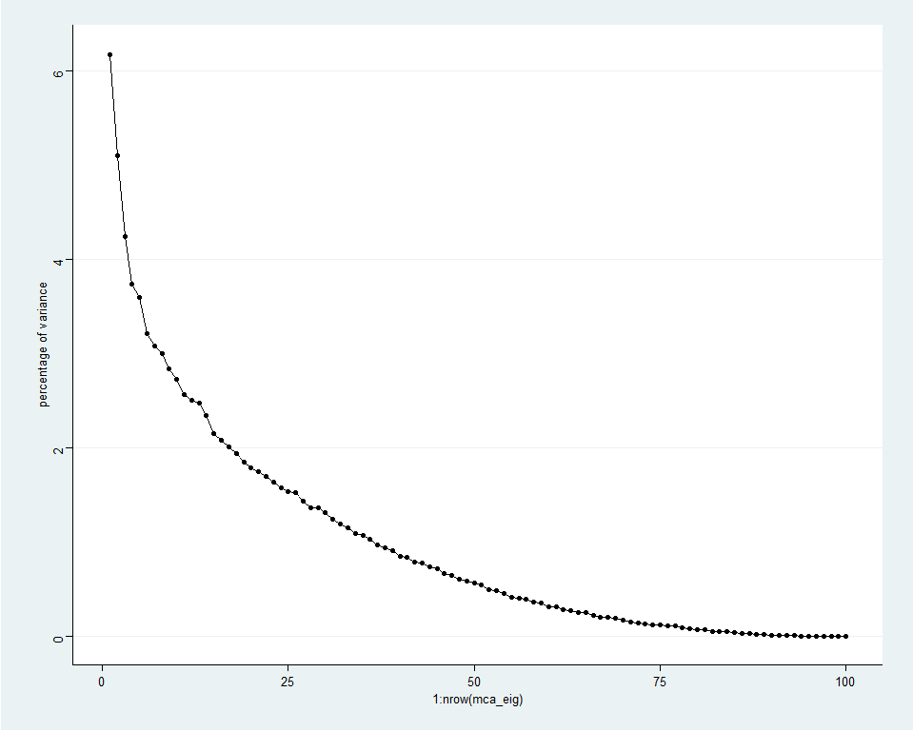
Correspondence Analysis
Continuous variables binned based on field expert knowledge and natural breakpoints in data
E.g. HGA1 of 5.7-6.0 is considered pre-diabetic, below this is normal and above is diabetic
Low overall percentage of variance explained

Slide 6
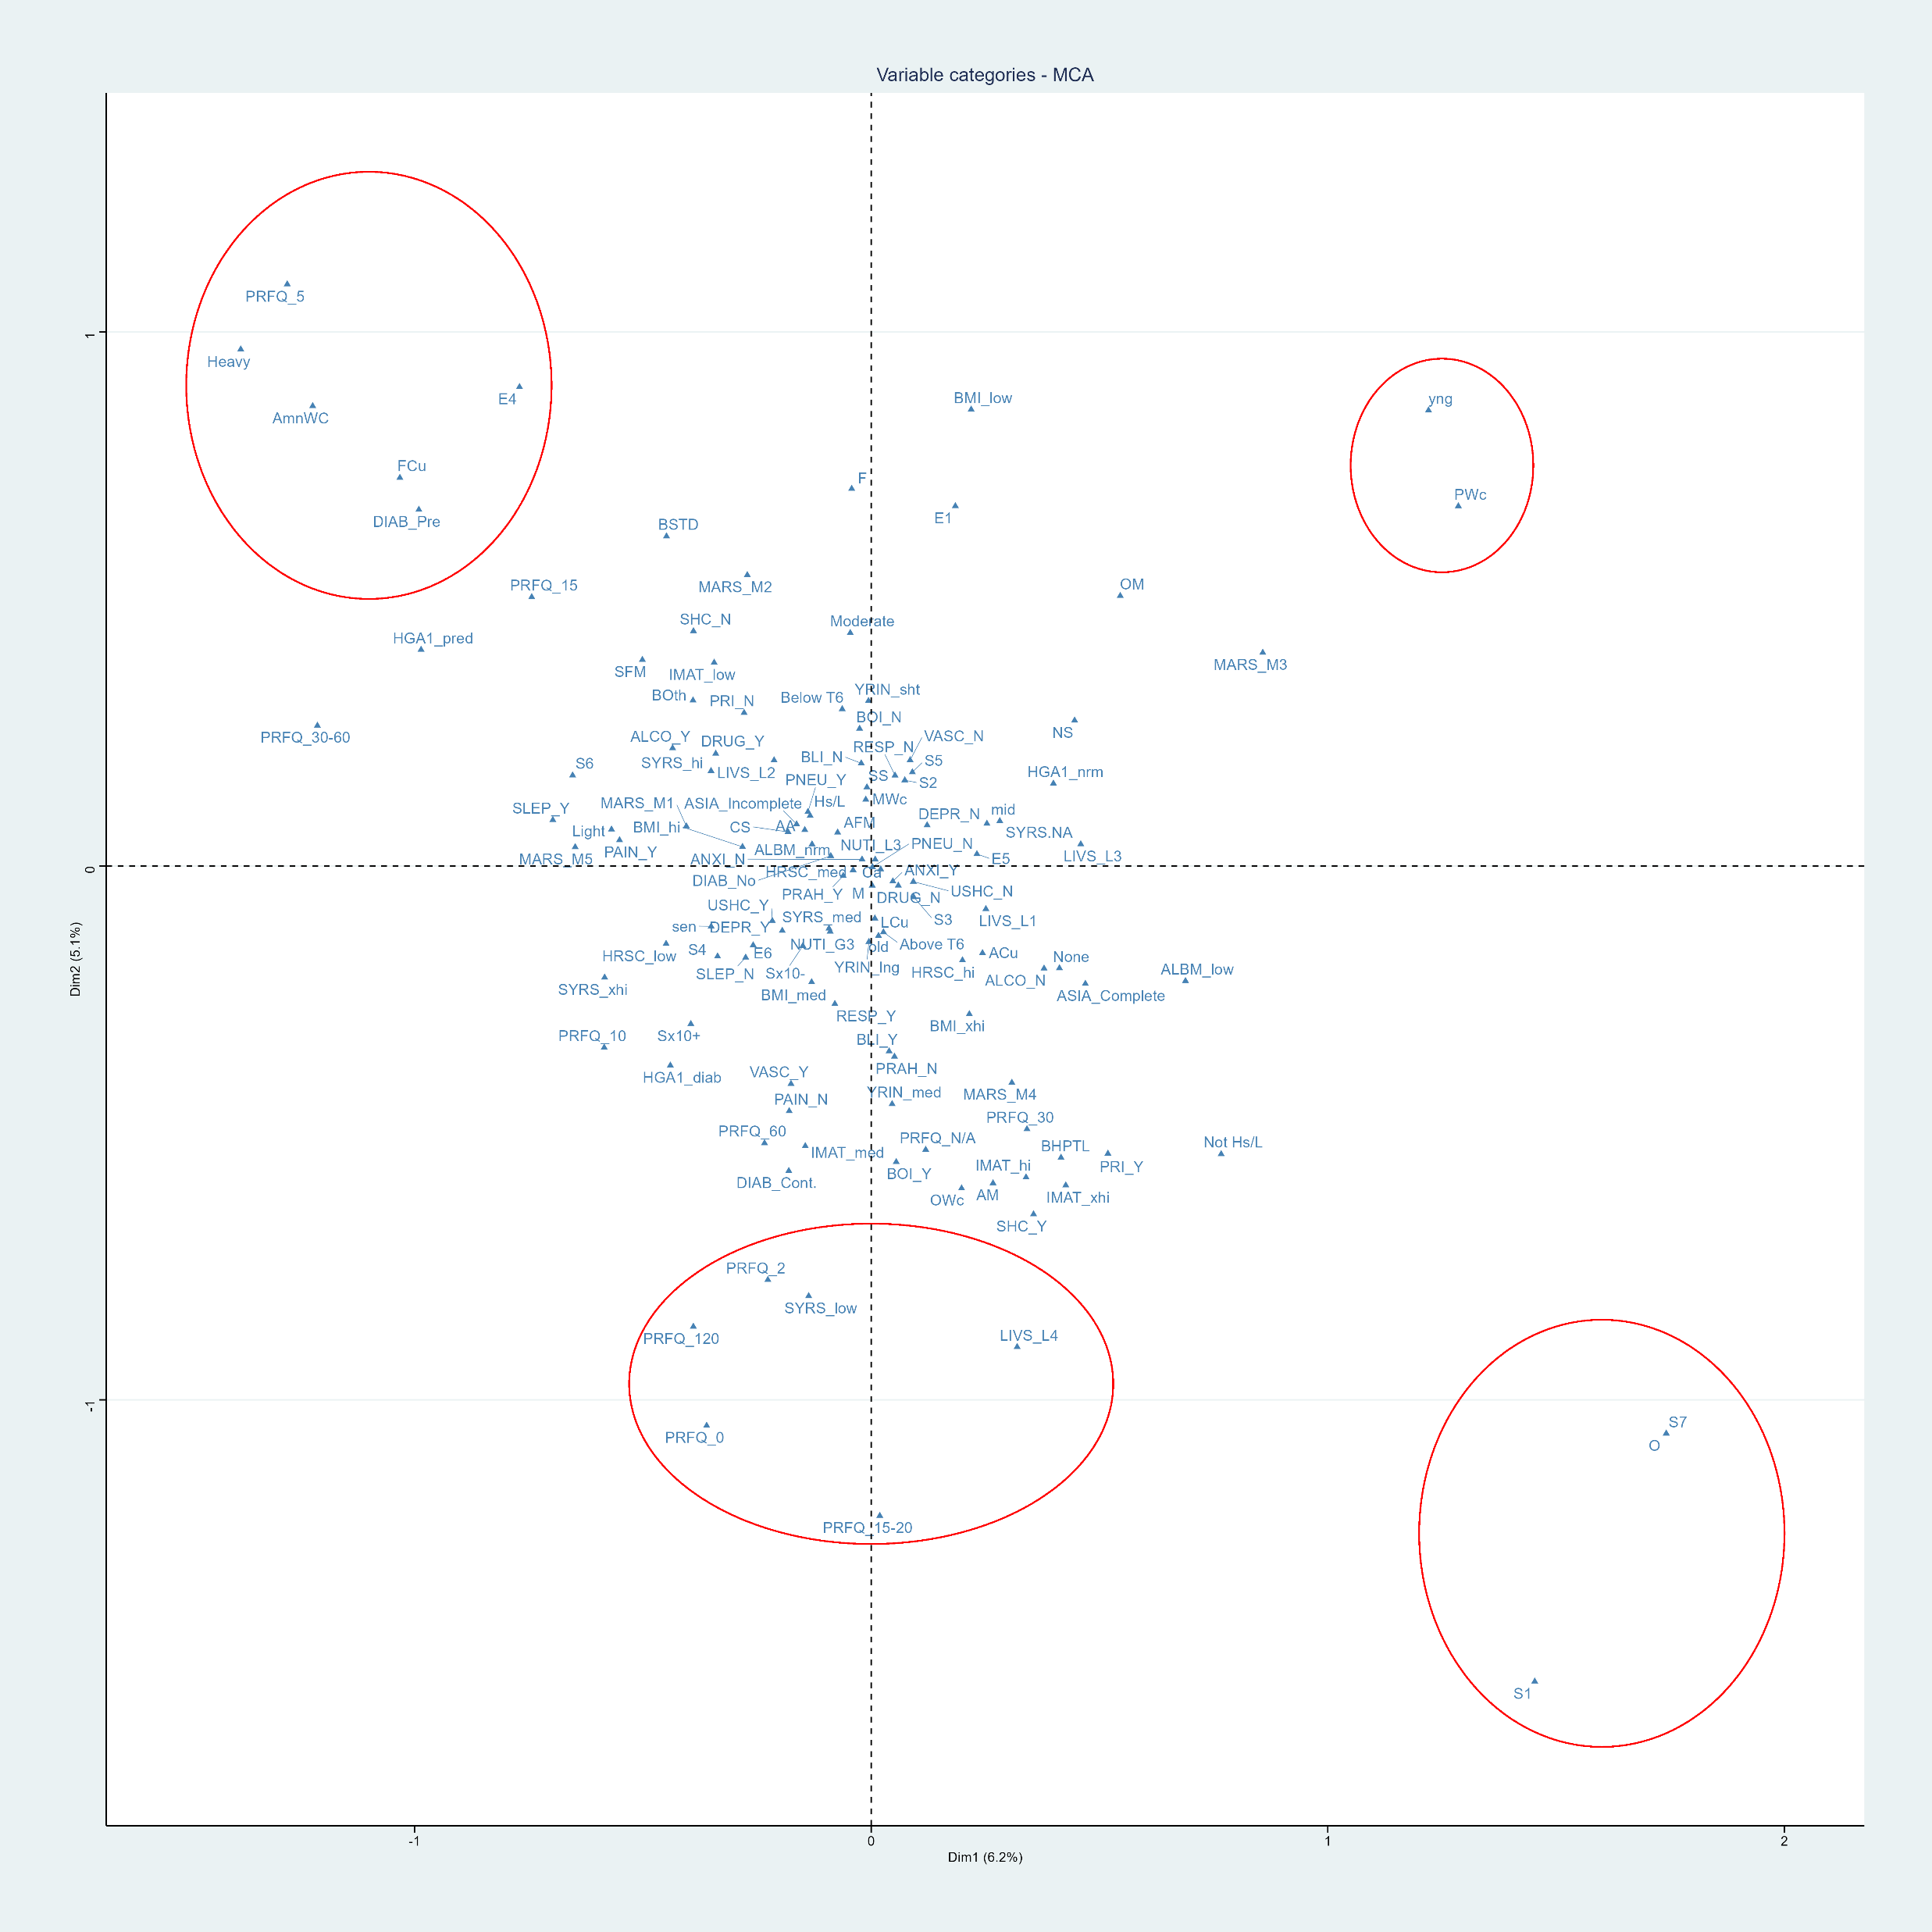
Correspondence Analysis – cont.

Slide 7
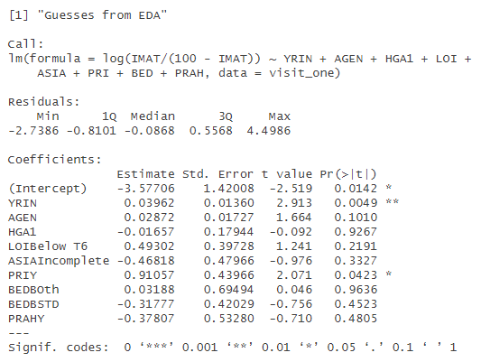
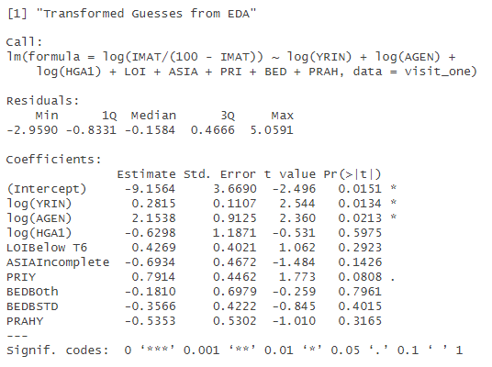
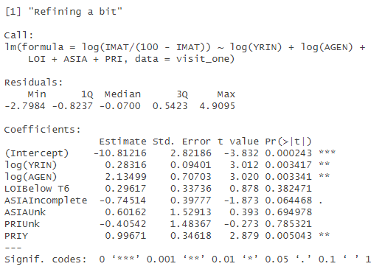
Preliminary Models
Focused on exploring variable relationships, not necessarily attempts to explain or predict data.
Try to understand relationship of IMAT to other potential explanatory variables.

Slide 8
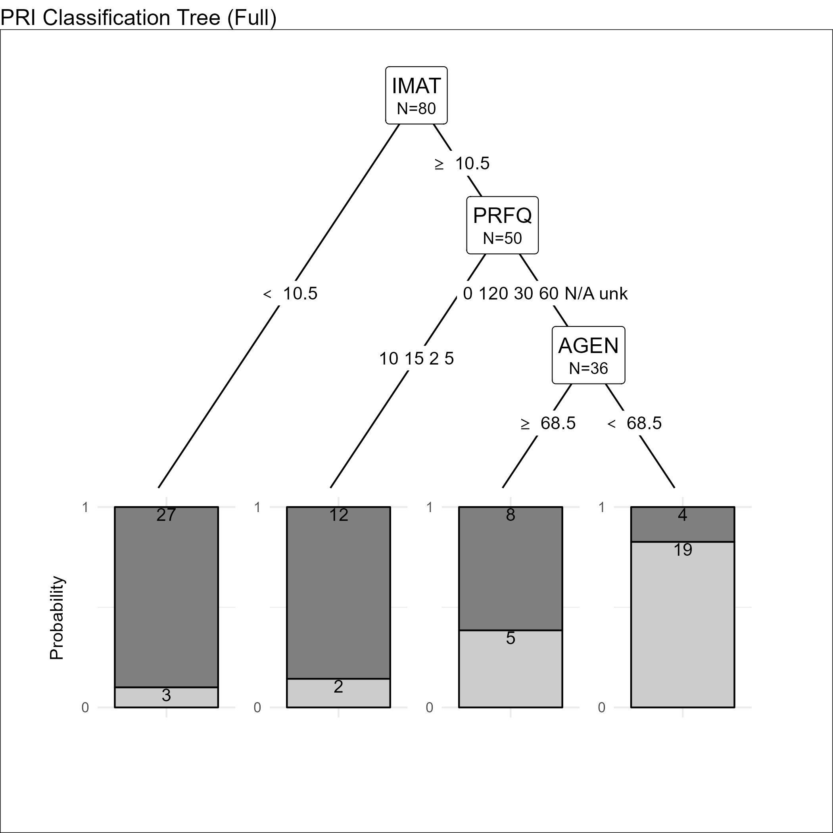
Preliminary Tree Models
Classification problem: does this veteran suffer from recurrent pressure injuries (PRI), given known features?
Split data into training and test sets
Use leave-one-out cross validation for training (small data set)
Problem: selected variables

Slide 9
An Aside: Variable Selection
“Medical” data is an intersection of biological, clinical, social, and treatment information.
Treatment information contains information about other likely or known variables.
E.g. Air cushions are a treatment for those with recurrent pressure injuries. If a veteran’s wheelchair has an air cushion, it is likely this was prescribed because they already suffer from PRI.
The model picks up on this information to better classify veterans, but it is not useful to practitioners.
The purpose of the study is to help practitioners identify veterans at risk for PRI.
Easy solution: leave out treatment variables directly related to PRI

Slide 10
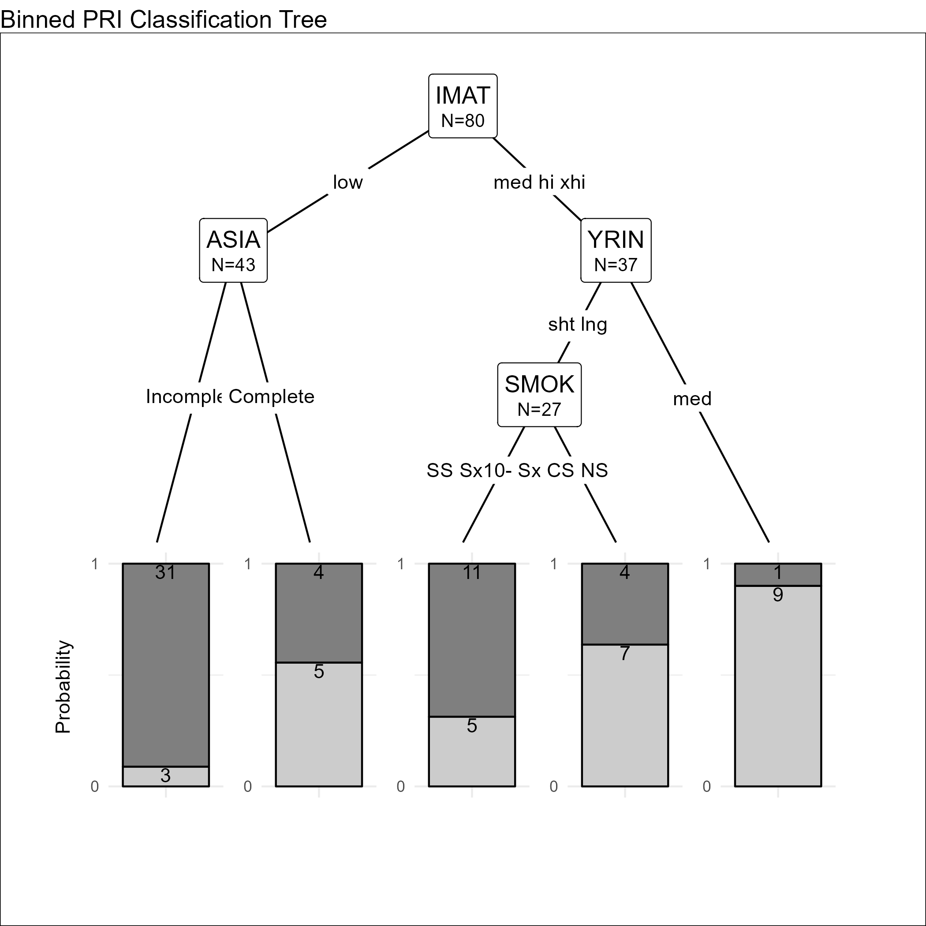
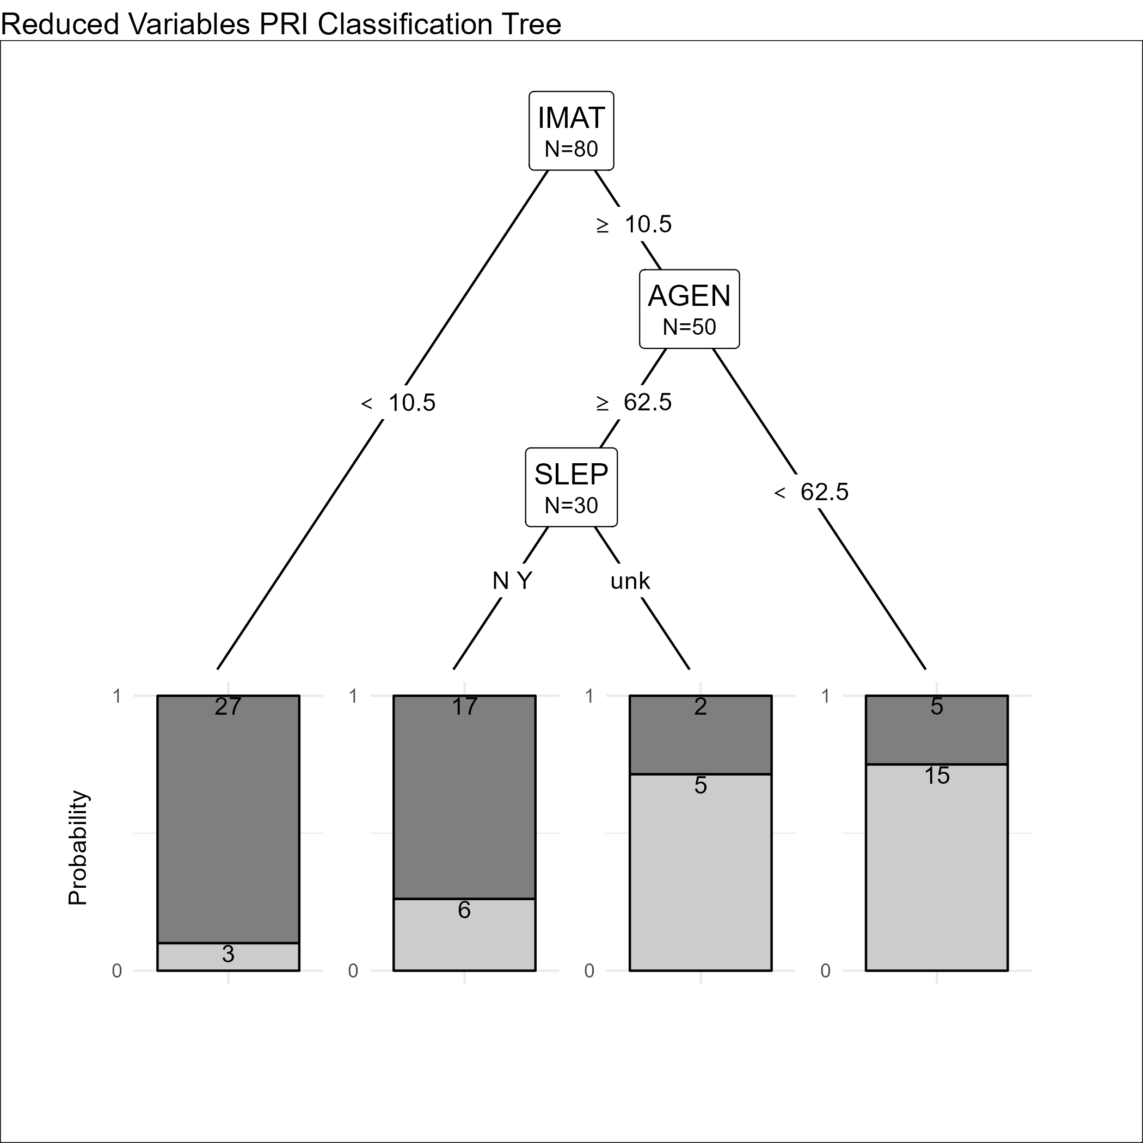
Improved Models

Slide 11
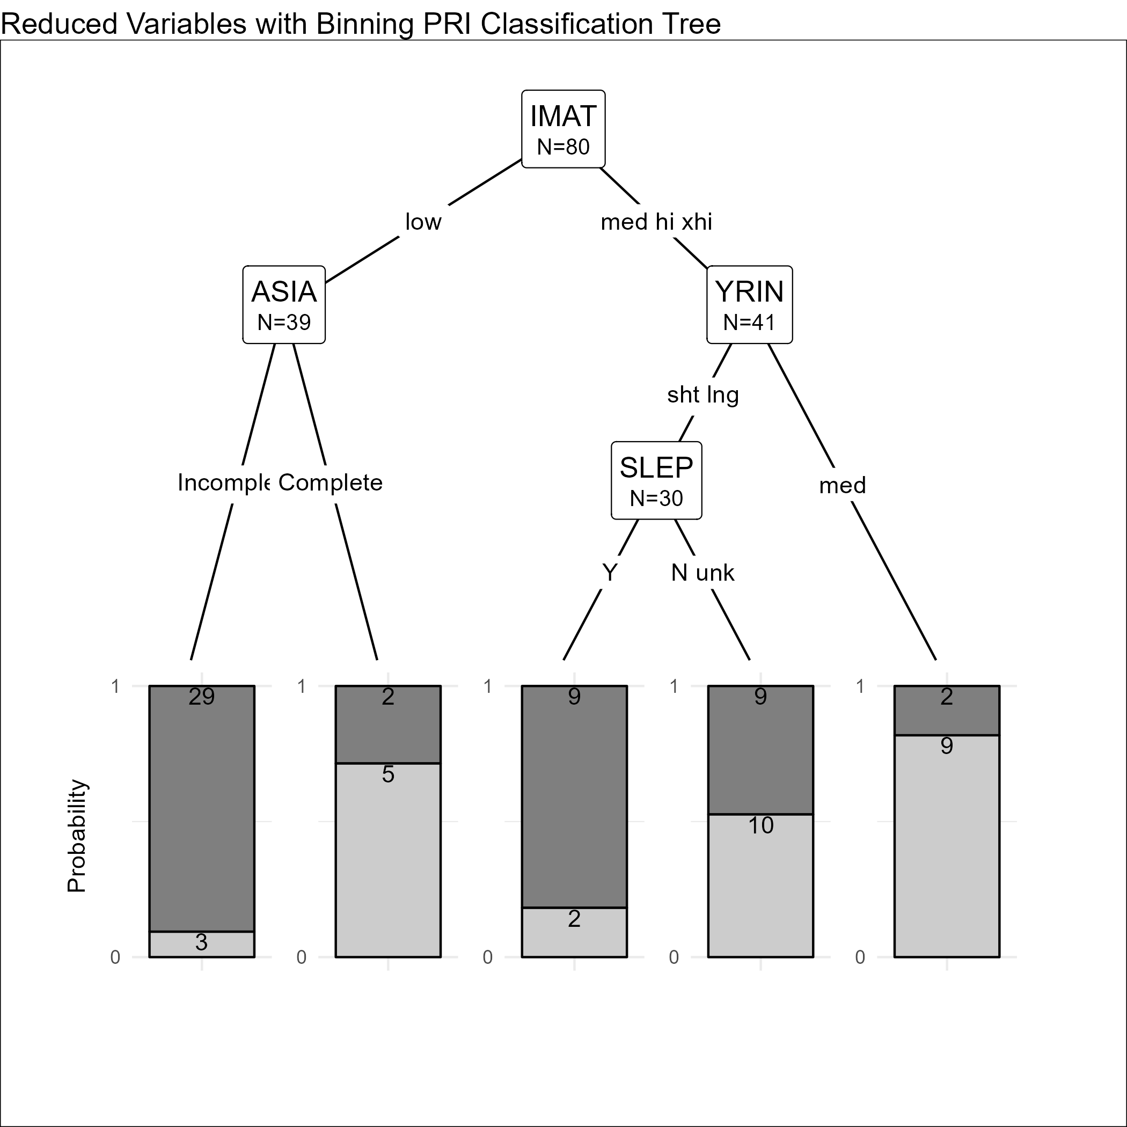
Improved Models – cont.
The binned and restricted model (using only variables thought by researchers to be related to PRI) separates on ASIA in an interesting way.
YRIN split may just be noise.

Slide 12
Improved Models - Evaluation
Tree | Accuracy | Sensitivity | Specificity | Precision
Full/test | 0.750 | 0.625 | 0.833 | 0.714
Full/train | 0.825 | 0.655 | 0.922 | 0.826
Binned/test | 0.700 | 0.625 | 0.750 | 0.625
Binned/train | 0.788 | 0.724 | 0.824 | 0.700
Restricted/test | 0.700 | 0.500 | 0.833 | 0.667
Restricted/train | 0.800 | 0.690 | 0.863 | 0.741
Restricted & Binned/test | 0.800 | 0.875 | 0.750 | 0.700
Restricted & Binned/train | 0.775 | 0.828 | 0.745 | 0.649
Interestingly, the reduced & binned model does almost as well as the unrestricted model in training and better in testing.
This could be chance, or the result of bringing prior expert knowledge to bear on the model. The models are close either way.

Slide 13

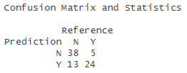
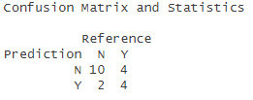

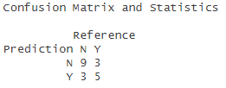
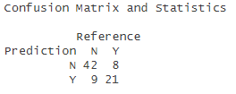
Some Thoughts
The models differ in false positive and false negative rates despite being close in accuracy.
A model can be chosen based on cost factors for a false positive/negative
With a best accuracy of 80%, the model has trouble predicting PRI in veterans based on clinical factors alone.
Which returns us to the main goal of the study: use genetic data to attempt to improve the ability to predict and understand recurrent pressure injuries in veterans.
Confusion Matrices for Reduced & Binned
Confusion Matrices for Reduced (no binning)
Confusion Matrices for Binned, Full

Slide 14
Wrap-Up
More modeling is possible with the current data regarding PRI
More classification methods like SVM, boosting, or deep learning could be used to built a prediction model.
However, these methods lead to interpretability issues in the resulting models, reducing value to clinicians and researchers.
More modeling is possible with the current data regarding IMAT
Methods like GLM, mixed effect models, partial least squares (PLS) and others could be used with reasonably interpretable outputs.
Boosting, deep learning, and dimensionality-reduction based methods could lead to good predictors (with above interpretability caveats)
Genetic data is likely to lead to better models.

Slide 15
Fin
Questions? Comments?

